Slide 1
INSTRUCTIONS
Use Font size 22 to 28 and Font Style Times New Roman (body)
Do not change the Template: Heading / Title of the slides
Do not change font style or colours
Do not copy paste paragraphs: use only Bullet Points
Maximum slide Limit is 20 only
As per the number of supervisor allotted adopt slide-2 or slide-3
Please display the required meaningful Content or images or tables
Change the footer accordingly using insert tab then click on header & footer tab and edit it
Save the PPT with Register No, Dept and Review no, example: 23xxxxxxxxx_CSE

Slide 2

Title: Design and Development of Responsive Restaurant Website
Student Name: K.Swathi Sree
Student ID: 2520030410
Cluster:4
Section: 14
Under the Guidance
of
Supervisor Name:NM Deepika
Assistant Professor
Department of CSE

Slide 3
OUTLINE
Abstract
Existing System
Proposed System
System Architecture
Project Modules
Objectives
Co’s Attainments - FWD
Co1
Co2 …….. 5. Co5
Co’s Attainments - DSA
Co1
Co2 …….. 5. Co5
Screen Shots for FWD & DSA
Conclusion
Geo-Tagged Photos

Slide 4
Abstract
Multi-Restaurant Online Food Ordering System is a web-based platform.
It allows users to browse and order food from multiple restaurants through a single website.
The main aim of the project is to make food ordering more convenient and efficient.
It brings different restaurants together on one platform for easy access.
Users can view menus from various restaurants available on the website.
Customers can select their preferred food items from different restaurants.

Slide 5
Existing System
In the existing system, customers usually order food from individual restaurant websites or separate food delivery applications.
Each restaurant maintains its own ordering platform.
Users must visit multiple websites or apps to browse menus from different restaurants.
Customers need to place orders separately for each restaurant.
Most systems allow the cart to contain items from only one restaurant.
Users cannot add food items from multiple restaurants into a single order.

Slide 6
Proposed System
The proposed system is a Multi-Restaurant Online Food Ordering Website.
It allows users to browse menus from different restaurants on one platform.
Users can add food items from multiple restaurants into a single cart.
The system provides a centralized website where many restaurants are available.
Customers can explore different food options easily without visiting multiple websites.
Users can select items from different restaurants and view them together in one cart.

Slide 7
System Architecture
Web Browser Interface – Users access the platform through a web browser to browse restaurants and order food.
HTML Structure – HTML is used to organize the website content such as restaurant menus, food items, and navigation sections.
CSS Design – CSS is used to design the layout, colors, and overall appearance of the website.
Responsive Interface – The website adapts to different devices like mobile phones, tablets, and desktops.
JavaScript Interactivity – JavaScript handles actions such as adding items to the cart and updating the cart dynamically.
User Food Selection – Users can browse multiple restaurants, select food items, and add them to a single cart.

Slide 8
Project Modules
Home Module – Displays restaurant introduction, logo, navigation menu, and welcome section.
Menu Module – Shows food categories, menu items, prices, and interactive menu display.
Gallery Module – Displays images of food items and restaurant ambiance.
Reservation Module – Allows users to book tables through an online reservation form.
Contact Module – Provides contact details, address, and a contact form for user queries.
Responsive Design Module – Ensures the website works properly on mobile, tablet, and desktop screens using CSS media queries.

Slide 9
Objectives
Develop a responsive website that allows users to browse restaurants and order food easily from different devices.
Provide an interactive user interface using HTML, CSS, and JavaScript for a better user experience.
Display restaurant menus and food items clearly so users can explore available dishes and prices.
Enable users to select food items and add them to a cart from multiple restaurants.
Implement dynamic cart functionality to update selected items before placing the order.
Ensure responsive design so the website works smoothly on mobiles, tablets, and desktops.

Slide 10
Co’s Attainments - FWD
CO1 Attainment: Internet Fundamentals, HTML & Introductory CSS
Developed the basic structure of the website using HTML including navigation bar, hero section, restaurant listings, and footer.
Applied basic CSS styling for typography, colors, spacing, and layout design.
Implemented responsive webpage structure using viewport settings and organized HTML elements.
CO2 Attainment: HTML Forms, Semantic Tags & CSS Layouts
Designed semantic HTML structure using elements like header, section, nav, and footer.
Implemented search bar and input elements for restaurant search functionality.
Applied advanced CSS layouts such as Flexbox/Grid and media queries to create a responsive interface.

Slide 11
Co’s Attainments - FWD
CO3 Attainment: JavaScript Programming Essentials
Implemented JavaScript logic for filtering restaurants and managing user interactions.
Used arrays and objects to store restaurant and food item data.
Applied functions, conditions, and loops to handle dynamic content and user actions.
CO4 Attainment: JavaScript Interactivity & DOM
Used DOM manipulation to dynamically display restaurant data and update the interface.
Implemented event handling for buttons such as search, filters, cart, and theme toggle.
Managed cart updates and notifications using JavaScript events.

Slide 12
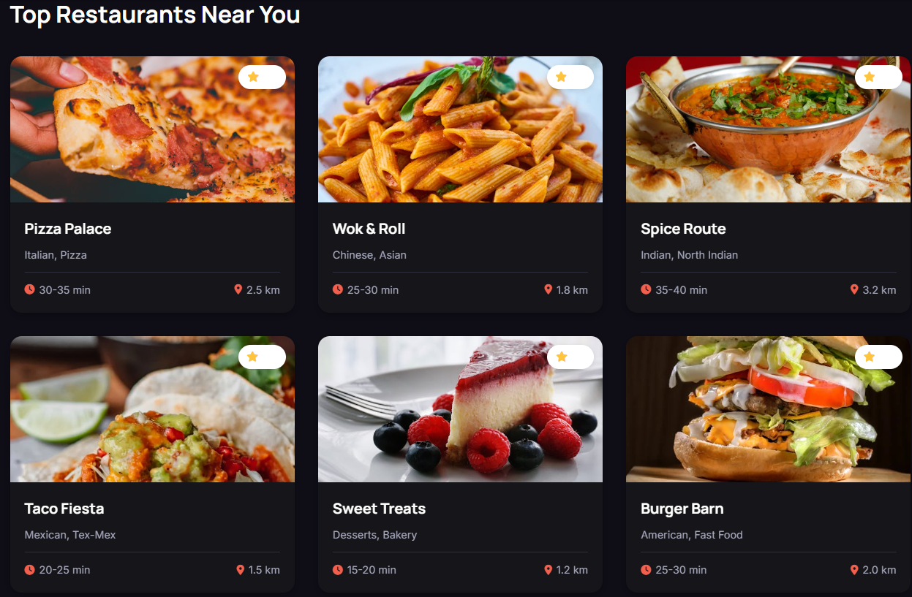
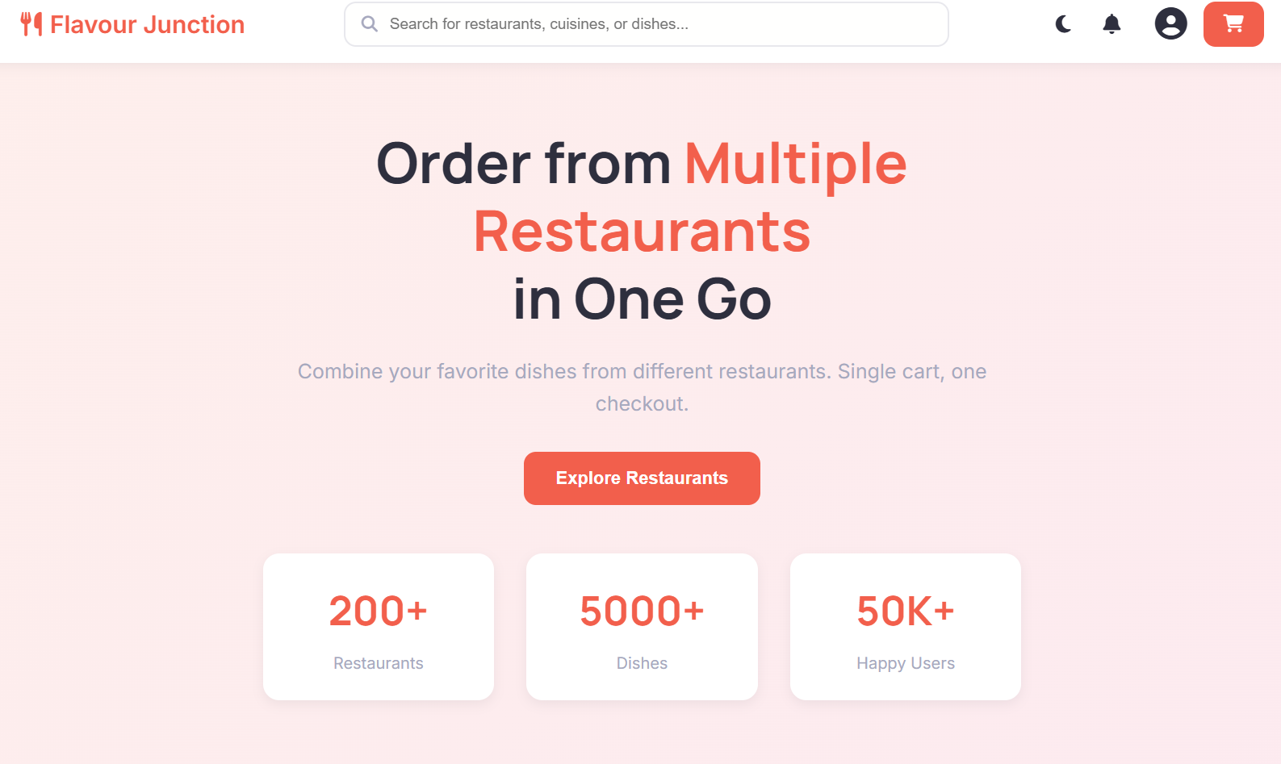
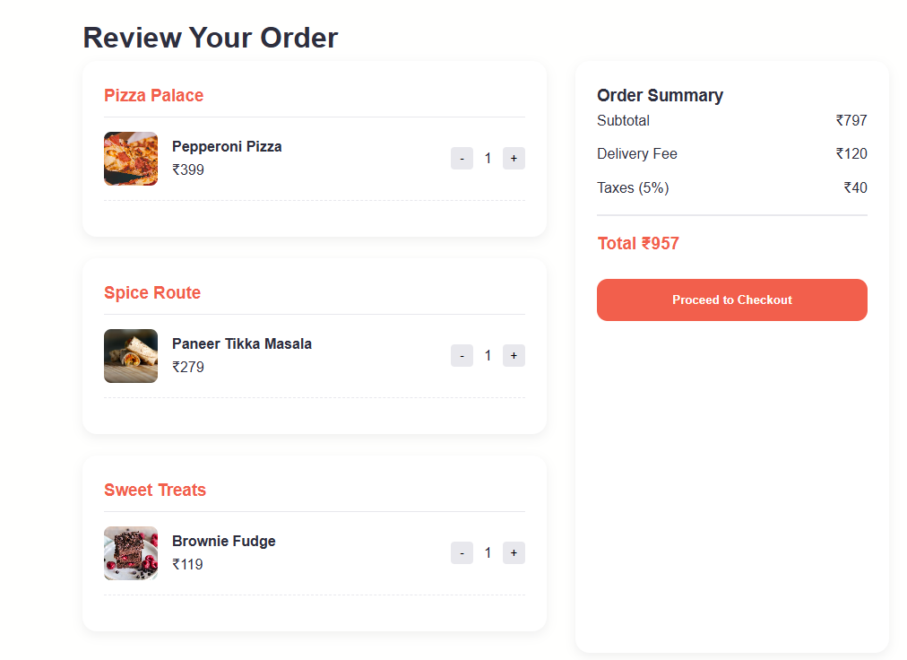
Screenshots for FWD

Slide 13
Conclusion
The Multi-Restaurant Online Food Ordering Website was successfully developed using HTML, CSS, and JavaScript.
The platform allows users to browse multiple restaurants and select food items easily.
Users can add items from different restaurants into a single cart and review them before placing an order.
Features like search, filters, sorting, and cart management improve the user experience.
The website uses responsive design, making it accessible on mobile, tablet, and desktop devices.
JavaScript interactivity enables dynamic updates, event handling, and smooth user interaction.
Overall, the project demonstrates an efficient and user-friendly online food ordering system using modern web technologies.

Slide 14
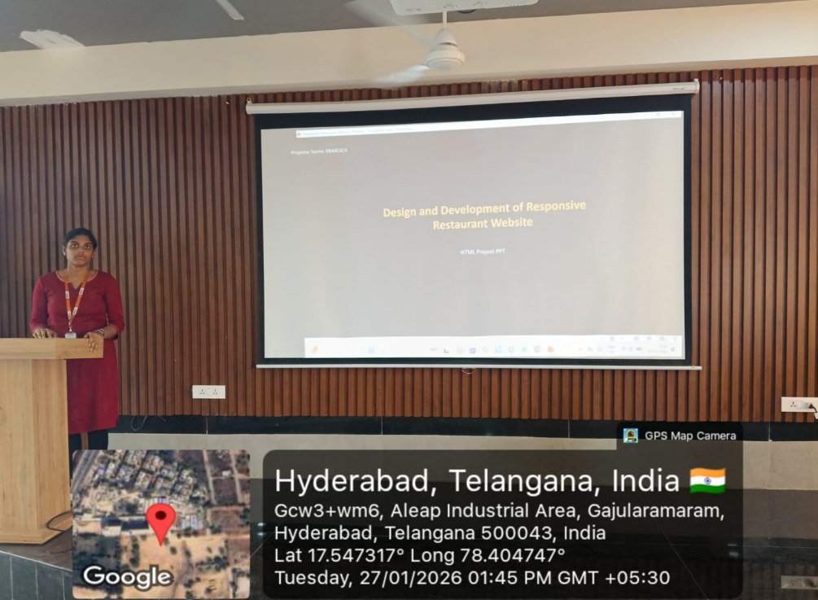
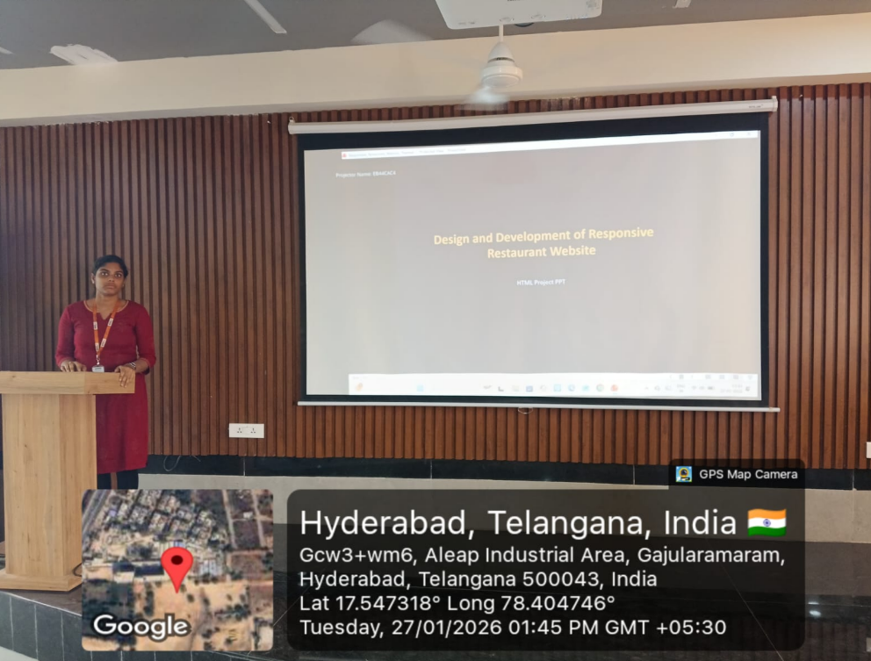
Geo- Tag Photos

Slide 15
THANK YOU

